Slide 1
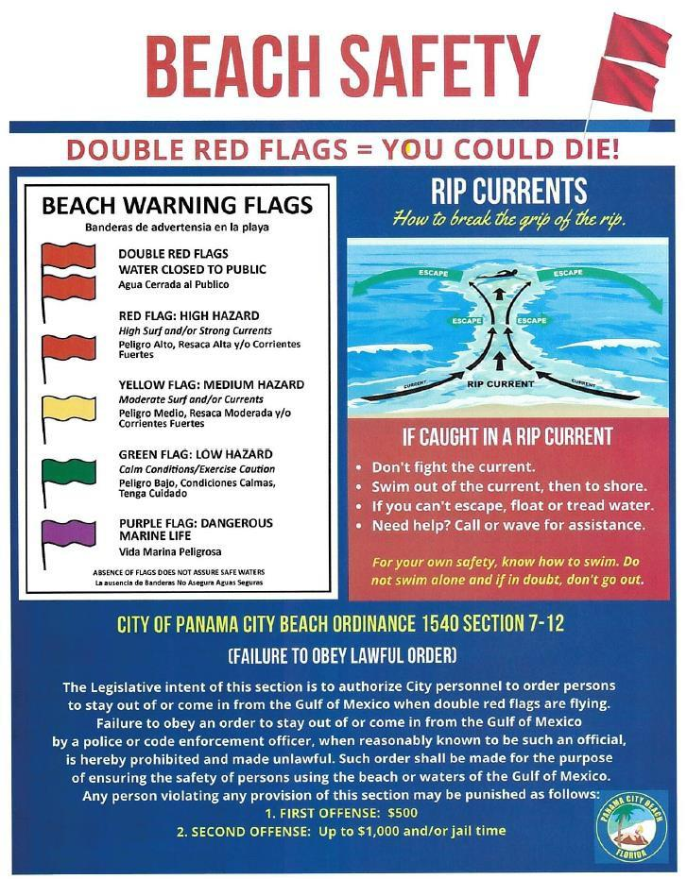
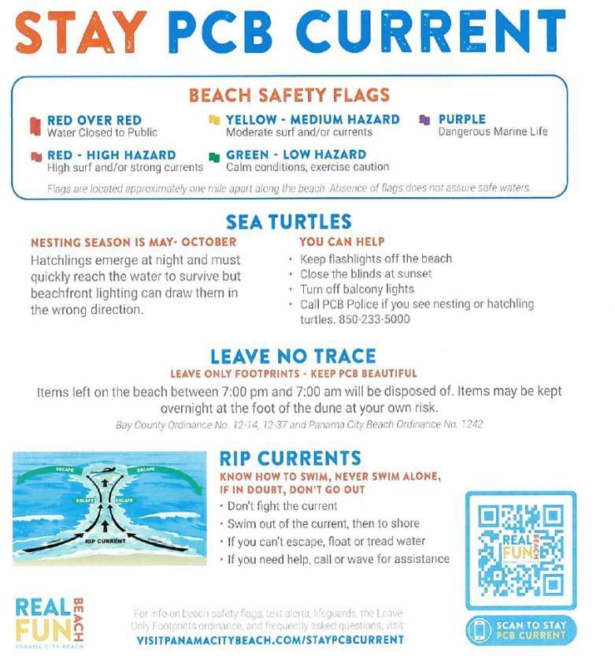
Resort Name
Unit _____
Address
PANAMA CITY BEACH, FL ______
CERTIFICATE NUMBER: XXXXX
GRILLING ON BALCONIES
PROHIBITED PER FLORIDA LAW
CHECK IN TIME: |  | CHECK OUT |  |  | WIFI ACCESS:
MANAGEMENT: |  |  |  | CONTACT INFO:
SECURITY: |  |  |  | SECURITY CONTACT:
MAX OCCUPANCY: |  |  |  | PARKING
TRASH CHUTES ARE LOCATED _______________________
SAFETY ORDINANCE INFORMATION
City Ordinance No. 1686 prohibits to make, cause, or allow the making of any noise, sound, or vibration which exceeds the limits set
forth in this Ordinance. Fines up to $500 and/or potential Criminal Offense.
City Ordinance No. 1301 prohibits animals on the beach. Pets are only allowed on a designated portion of the beach west of Pier Park. Fines - first offense is a $50 fine, second and subsequent offenses are $100.
City Ordinance No. 1597 prohibits smoking and vaping in city parks and beaches. Fines - first offense carries a $100 fine, while a second
offense is $250, third and subsequent offenses are $500.
Trash Removal: Please remove all trash from unit upon check-out and place in trash chute located near elevators on each floor. All trash must be kept in containers. Trash chute is available 24/7.
Parking: All parking is located in lot in front of the building. All vehicles are required to display a valid parking pass in vehicle. Unauthorized vehicles will be towed at guest expense.
Balcony: It is a Class 3 felony to throw any items from a balcony. Do not hang any items on balcony railing.
Penalties for Non-Compliance: Failure to conform to local ordinances such as noise, parking and occupancy requirements is a violation of City code and may result in tickets or citations. Minimum fine is $500 and increases with subsequent offenses.
MEDICAL CARE |  |  | CALL 911 IN CASE OF AN EMERGENCY
CLOSEST HOSPITALS |  |  | HCA Florida Gulf Coast Hospital 9318 PCB Parkway, PCB, FL 32407 |  |  | Ascension Sacred Heart Emergency Care 11111 PCB Parkway, PCB, FL 32407

